Slide 1
Search Systems
Group 5

Slide 2
Basics of search systems
What we'll cover:
Determining whether your site needs a search system
The basic anatomy of a search system
What to make searchable
A basic understanding of retrieval algorithms
How to present retrieval results
Search interface design

Slide 3
History of search systems
History of Search Engines: From 1945 to Google
As We May Think (1945): The concept of hypertext and a memory extension really came to life in July of 1945
Gerard Salton (1960s - 1990s):
Gerard Salton, who died on August 28th of 1995, was the father of modern search technology. His teams at Harvard and Cornell developed the SMART informational retrieval system. Salton’s Magic Automatic Retriever of Text included important concepts like the vector space model, Inverse Document Frequency (IDF), Term Frequency (TF), term discrimination values, and relevancy feedback mechanisms.
Ted Nelson:
Ted Nelson created Project Xanadu in 1960 and coined the term hypertext in 1963. His goal with Project Xanadu was to create a computer network with a simple user interface that solved many social problems like attribution.

Slide 4
During the early development of the web, there was a list of webservers edited by Tim Berners-Leeand hosted on the CERN webserver. One historical snapshot from 1992 remains.[1] As more webservers went online the central list could not keep up. On the NCSA site new servers were announced under the title "What's New!"[2]
The very first tool used for searching on the Internet was Archie.[3] The name stands for "archive" without the "v." It was created in 1990 by Alan Emtage, a computer science student at McGill University in Montreal. The program downloaded the directory listings of all the files located on public anonymous FTP (File Transfer Protocol) sites, creating a searchable database of file names; however, Archie did not index the contents of these sites since the amount of data was so limited it could be readily searched manually.

Slide 5
Timeline of history
YearEngineEvent1993W3CatalogLaunchAliwebLaunchJumpStationLaunch1994WebCrawlerLaunchInfoseekLaunchLycosLaunch1995AltaVistaLaunchOpen Text Web IndexLaunch[1]MagellanLaunchExciteLaunchSAPOLaunch1996DogpileLaunchInktomiFoundedHotBotFoundedAsk JeevesFounded1997Northern LightLaunchYandexLaunch1998GoogleLaunch1999AlltheWebLaunchGenieKnowsFoundedNaverLaunchTeomaFoundedVivisimoFounded2000BaiduFoundedExaleadFounded2003Info.comLaunch2004Yahoo! SearchFinal launchA9.comLaunchSogouLaunch2005MSN SearchFinal launchAsk.comLaunchGoodSearchLaunchSearchMeFounded2006wikiseekFoundedQuaeroFoundedAsk.comLaunchLive SearchLaunchChaChaBeta LaunchGuruji.comBeta Launch2007wikiseekLaunchedSprooseLaunchedWikia SearchLaunchedBlackle.comLaunched2008PowersetLaunchedPicollatorLaunchedViewziLaunchedCuilLaunchedBoogamiLaunchedLeapFishBeta LaunchForestleLaunchedVADLOLaunchedSperse! SearchLaunchedDuck Duck GoLaunched2009BingLaunchedYebolBeta LaunchMugurdyLaunchedGobyLaunched2010TimmpLaunched
www.wikipedia.org

Slide 6
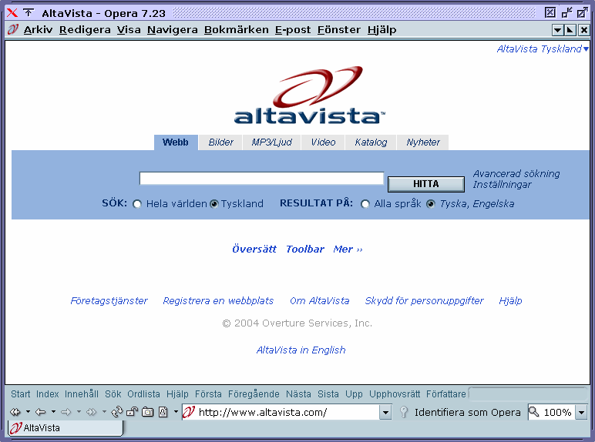
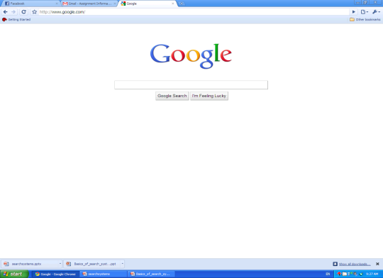
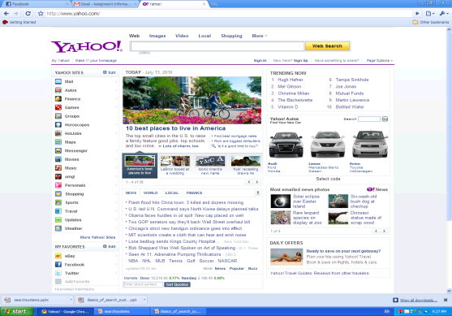
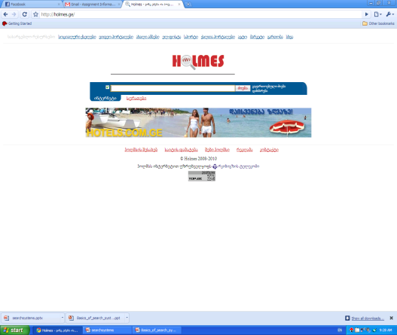
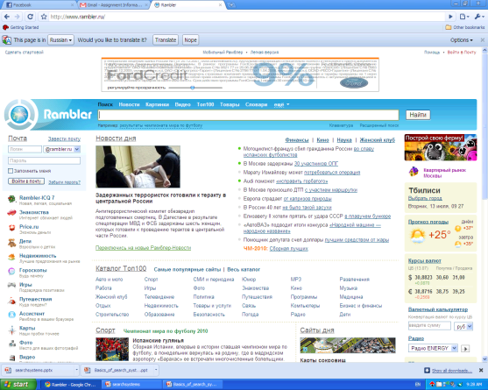
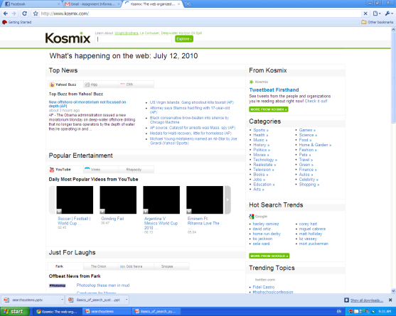
Examples

Slide 7
Examples
We use search engines every day, without thinking. But few people know how they work, as there were, and how to use them properly.

Slide 8
List of popular search
Ask.com
Baidu
Bing
Cuil
Duck Duck Go
Google
Kosmix
Sogou
Yodao
Yahoo! Search
Yandex
Yebol

Slide 9
Web search Engine Architecture

Slide 10
Search Zones
Subsets of the site that have been indexed separately.
Example http://search.dell.com/index.asp
Amazon does a great job of this
Can be: content type, audience, role, topic, geography, chronology, department

Slide 11
Types of Pages
Navigation pages – pages that help you browse a site
Destination pages – contain actual information
Want to make sure search results contain mostly destination pages

Slide 12
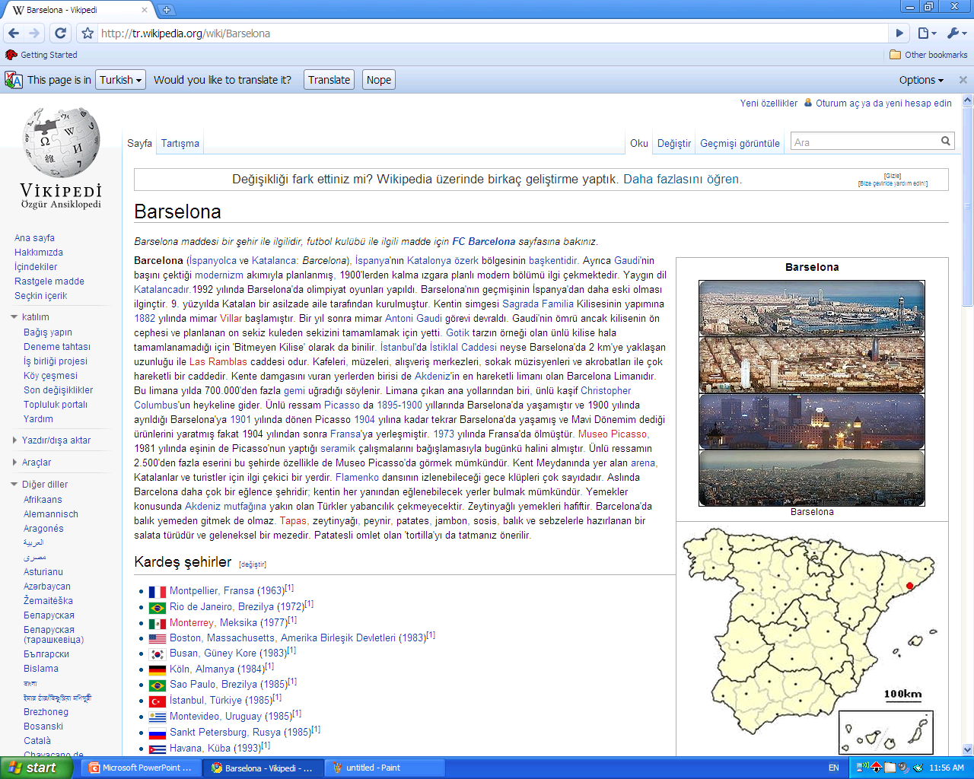
Navigation page
Destination page

Slide 13
Search Algorithms
There are many types of algorithms available.
The bottom line is to select the one that is appropriate for the type of search capabilities required by the user.

Slide 14
Set Theoretic
Classic Models
Fuzzy
Extended Boolean
User
Tasks
Boolean
Vector space
Probabilistic
Retrieval:
Adhoc
Filtering
Algebraic
Generalized Vector
Lat. Semantic Index
Neural Networks
Structured Models
Non Overlapping
Lists
Proximal nodes
Probabilistic
Browsing
Inference Network
Belief Network
Language Models
Browsing
Flat
Structure Guided
Hypertext

Slide 15
Pattern Matching Algorithms
Most common, matches a string that user entered
Depending on your user’s needs you have to emphasize recall or precision.
Recall - #relevant docs retrieved / #relevant docs in collection
Precision - #relevant docs retrieved / #total docs in collection

Slide 16
Pattern Matching Algorithms
Automatic Stemming – expands a term to include other terms that share the same root
Eg: “word” gets you “password”
No Stemming – results contain just that word
Depends on the content you are indexing. Eg – course catalog

Slide 17
Query Builders
Tools that help SE performance – invisible to users
Spell-checkers – Google’s “did you mean”
Phonetic tools – sounds like
Stemming tools – same stem results
Natural language processing tools – how to
Controlled vocabulary – include synonyms

Slide 18
Query Builders

Slide 19
Presenting Results
What to display?
Title
Summary
Relevance score
Other parts of the structure of docs
Depends on your audience – more or less info – give users the option to see ‘detailed’ results if they choose – descriptive vs reprenstational
How many documents?
Number of retrieved docs
Number of results per page

Slide 20
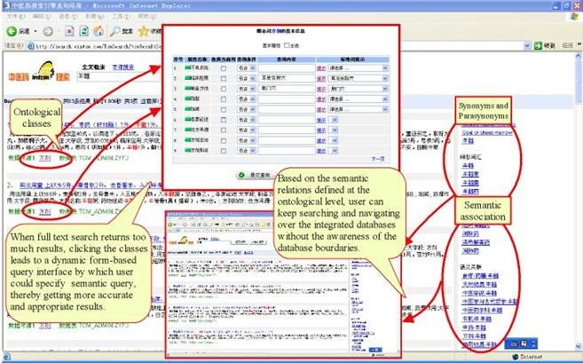

Slide 21
Listing Results
Sorting
Alphabetically
Chronologically
Ranking
By relevance
By popularity
By users’ or experts’ ratings
By pay-for-placement

Slide 22
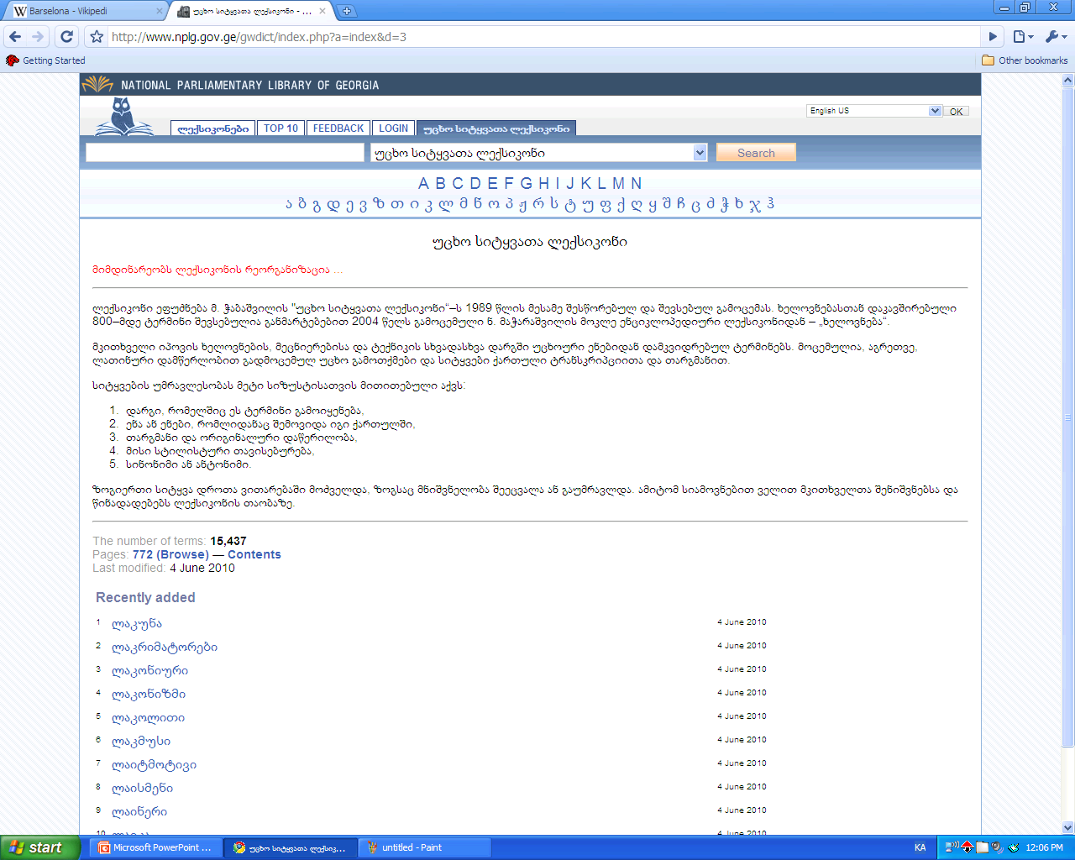
Alphabetically

Slide 23
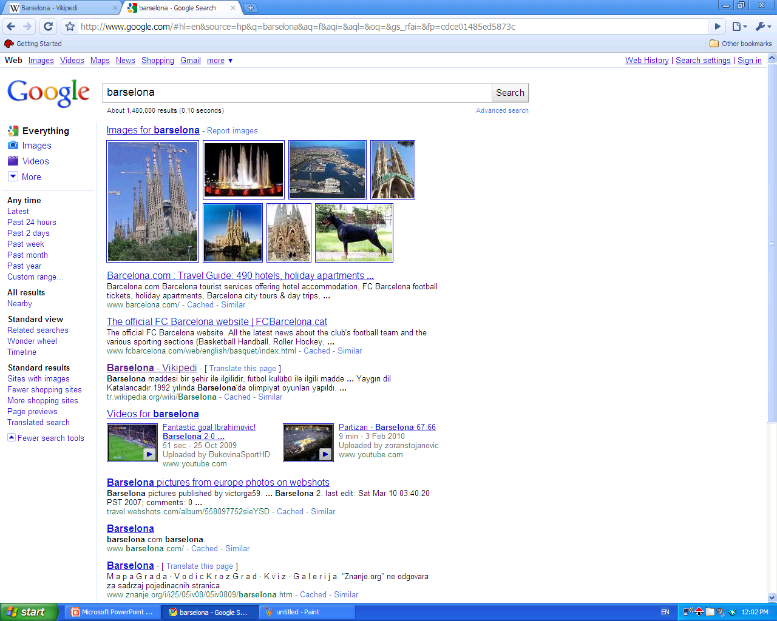
Chronologically

Slide 24
Search marketing
Search system marketing, is a form of Internet marketing that seeks to promote websites by increasing their visibility in search engine result pages through the use of search engine optimization, paid placement, contextual advertising, and paid inclusion.

Slide 25
Search interface
With much variation among users and search-technology functions, there can be no single ideal search interface. Although the literature of information retrieval includes many studies of search interface design, many variables preclude the emergence of a "right way" to design search interfaces.

Slide 26
Search interface
Are users comfortable with specialized query languages (e.g., Boolean operators), or do they prefer natural language? Do they need a simple or a high-powered interface?
Do users want just a taste, or are they doing comprehensive research? What content components can help them make good decisions about clicking through to a document?
Is the information made up of structured fields or full text? Is it navigation pages, destination pages, or both? Is it written in HTML or other formats, including nontextual?
Will users be overwhelmed by the number of documents retrieved? How many results is the "right number"?

Slide 27
Search interface
SEARCH BOX
Governmental portal of Uzbekistan
National Search System of Uzbekistan

Slide 28
Search interface
Georgian search systems

Slide 29
Advanced interface
Advanced search interfaces are where much of the search system's functionality is "unveiled" to users.
Advanced search interfaces allow much more manipulation of the search system and are typically used by two types of users: advanced searchers (librarians, lawyers, doctoral students, medical researchers), and frustrated searchers who need to revise their initial search (often users who found that The Box didn't meet their needs).

Slide 30
Advanced interface

Slide 31
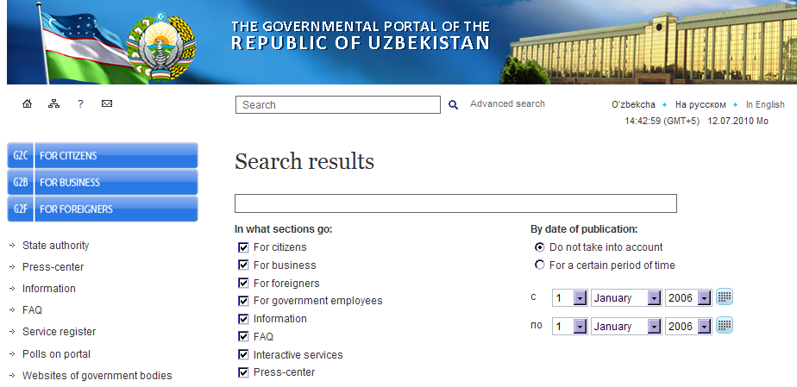
Advanced interface

Slide 32
Trends in the future
What is this next level of search systems? What technology will revolutionize the way we receive our search engine results?
The search results we receive in just a couple of years from now could make current search engine technology look as archaic and cumbersome as picking up a Yellow Pages book is today. However, in order to achieve this new search nirvana we, as consumers, must quell our fears and trepidations surrounding the protection of our privacy. In order for the search engines to develop technology that will be intuitive and anticipate our every need, we must first relinquish at least some of the privacy that we currently hold so dear.

Slide 33
Trends in the future
Let ‘s search system to track users online activities, allowing it to monitor the web sites user view and keep a log of all of the search queries entered by user. This type of information could greatly improve the relevancy of the results displayed.
Another area with great potential for improving search engine results will be developed by search within email. We could be offered the option of paying a monthly premium in order to not have ads shown when we read our email, but if they are relevant to the content of a received message, why would we want to block them?

Slide 34
Trends in the future
Another development in search engine technology that I can see happening would come from the development of Microsoft's new Longhorn operating system. Imagine an operating system that monitors all of your activities -- with your permission, of course. Every file, every image, word document, mp3, even e-books could be monitored by your computer as it endeavors to anticipate your every need. Not only could an integrated search engine allow you to search files located on your hard drive, but it could also use the information it has collected from these files to make your online search experience even more enjoyable.

Slide 35
Discussion Questions
How has the search engine changed the way we use the web?
Where do you see it going in the future?
Search Engines – Pros / Cons
Articles

Slide 36
Thank you

