Slide 1
Search System on Europa.eu
Group 5

Slide 2
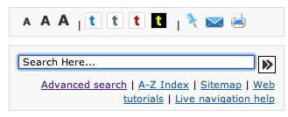
Interface
Simple search field alongside other elements

Slide 3
Advanced Search Interface

Slide 4
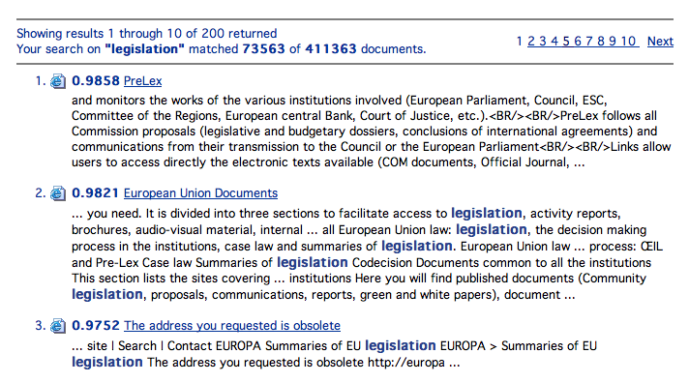
Results sorted by relevance score

Slide 5
Ability to restrict search to specific domain, language, file format

Slide 6
Ability to use search logical operators

Slide 7
Results display file icons to demonstrate document type

Slide 8
Improvements
More possibilities to refine results, e.g. by
Date
Speaker
Publication Topic
More personalization possibilities, like
Exporting results
Expanding results to include other external sources
User generated tags

