Slide 1
Electronic resource discovery systems: do they help or hinder in searching for academic material?
Findings from a User Behaviour Study:
UBiRD: User Behaviour in Resource Discovery
Hanna Stelmaszewska, Nazlin Bhimani, William Wong and Balbir S. Barn
Middlesex University, 2010
This presentation was given at the ALT-C conference by Professor Balbir S. Barn in September 2010.

Slide 2
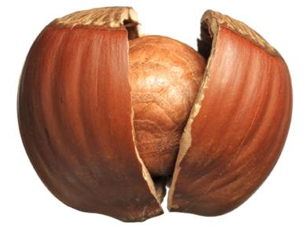
The Main Result (in a nutshell….)
This paper offers deep qualitative evidence of how Electronic Resource Discovery Systems help or hinder students and researchers information seeking activities when searching for quality materials
Keys issues are:
Information as well as Digital literacy
Support for the resource discovery process
Address usability across the domain and support integration of ERDS

Slide 3
Context
UKHE Libraries are spending significant proportion of their budget on electronic resources
Research Information Network Report: £79.8M for e-journals in 2006/7 (total expenditure: £112.7M)
Estates Strategies: focus on mobility and information anywhere
Increasing use of e-learning/distance learning
Perception by Librarians and Academic staff that students are not accessing quality library-subscribed resources and are using Google… (Fieldhouse 2008)
Why is this? What are the barriers?

Slide 4
The study: aims
To identify, understand, compare the information-seeking behaviour of students and researchers from the Business and Economics discipline subject area
Recommendation to JISC
Publishers of Electronic Resources
Librarians working in the HE sector
Notes:
The aims of the study is to….
As this is a qualitative research its purpose was to provide richer descriptions of not just what people do, but also to seek to find insight as to why they do what they do.

Slide 5
Methodology
Focus Groups:
2 groups of 9 students
Initial Analysis and Task Design
Task Design
Domain understanding
Systems
Observation Studies:
Think-aloud
Video recording
Transcription
40-80 minutes of video
34 participants
Qualitative data collection
In total: 34 participants (16 female, 18 male)
Middlesex University: 12 (5 UG, 3 PG & 4 Researchers)
London School of Economics: 12 (5 UG, 4 PG & 3 Researchers)
Cranfield University: 10 (6 PG & 4 Researchers)
Observation of usage of systems
1-1 Interviews
Focus Groups:
2 groups of 9 students
Data Analysis
Emergent
Themes Analysis

Slide 6
Task Design
Task 1: Find a range of examples from film and television programs, which illustrate product placement ‘in action’.
Task 2: Find evidence of film tourism from a range of different film industries to illustrate the impact this may have had on tourism.
Task 3: Imagine that you are the brand manager for a new range of mobile phones for Nokia; you required to produce evidence to demonstrate how you might use the film/television medium as a way of reaching your target audience.

Slide 7
Key Findings
Usage and Experience
Making choices
Immediate access: integrated resources
Confusion: dealing with different systems
Structure vs. Semantics
Need for storage and how it is used
Notes:
9 important issues emerged from the study and have impact on their information seeking experience.
Today I’ll discuss just a few of them in detail.

Slide 8
Resource discovery tools: Usage vs Experience
Internal (academic)
External (non-academic)
Notes:
Different resources were used: academic and non-academic. Academic: are the once subscribed by library (e.g. EBSCO, ProQuest or a library catalogue) non-academic are freely available on the Internet resources such as Google, YouTube, Yahoo).
It seams that as information literacy experience increases the level of use of ‘internal’ resources increases as well.
We found out that ‘internal’ resources were more frequently used by PG and Experts.
For instance: EBSCO, Emerald were common within more experienced users PG & Experts whereas library catalogue was more frequently used by UG.

Slide 9
ERDS: Making Choices
Knowledge of the subject
Pre-defined categories
“In the marketing databases ... they have different categories: business, consumer goods so I have to know what to check” CP5 (PG).
Knowledge of strengths and limitations of resources
CP5 (PG) says with reference to the Social Science Research Network (SSRN), “I know that this site will not give me the full papers but will give me the names [i.e. references]”
Trust
“It came from Google Books so it’ll be ok” (LP2, UG).
“I will go back to Google to help me get my bearings … ” (LP7, EX)

Slide 10
Information literacy vs Information Technology literacy
Poor usability, high complexity and lack of integration as a barrier to information search and retrieval
Users are distracted from focusing on the content, analysis and evaluation
Users have poor understanding of how to access the quality of material
“ I don’t always know which is the most appropriate [database]”, (CP2, Researcher)
“…cinema would not be at the LSE for sure” (LP2, UG)
Notes:
One of them is ‘Information literacy and Information Technology literacy. When we talk about information literacy we refer to individual’s ability to recognize the need for information and the ability to locate, evaluate and use information effectively whereas information technology literacy refers to the ability to operate the user interface, the understanding of how the technology is designed to enable the search and how to use this technology most efficiently.
In the UBiRD study, we have found these two overlap.
We have found that the poor usability, high complexity, and lack of integration of many electronic resource discovery systems, have raised the threshold of information technology literacy, and this acts as a barrier to information search and retrieval.
> participants were unclear about what resources were available and appropriate for their immediate needs.
They didn’t know how to access the resources, how to collect keywords, create a search strategy and search effectively and efficiently
Often they did not have an understanding of the difference between library-provided resources and those freely available on the Internet
Users were unaware of the scope of their own institutions’ library collection LP2
Many of them didn’t remember the training they received during the induction week.
> Users were confused about multiple access points different access rights, different user interfaces, different access structure
> This increase in the level of difficulty, which distracts users from focusing on the content, analysis and evaluation that would help them learn and make sense of what they have discovered.
> In addition, we have also found evidence to suggest that information literacy skills are lacking.
> many of the participants do not understand how to assess the quality of materials they find.
Google or Google Scholar have lower thresholds of information technology literacy, and are considered their “… friends” because of the apparent higher yield or success rate.
“I wouldn’t have to use Google Scholar so much if the internal resources were more user friendly”. (MP12, PhD student)

Slide 11
Immediate access: integrated resources
Users want easy, quick and unproblematic access
Browsing books in the library was too time-consuming
The failed “promise” of a full text article because of
Embargoes
Subscriptions
Perception that Google is quicker and Google Scholar provides a wider range of sources remains.
“ I don’t know why you can’t . . .they might have changed the functionality. You used to be able to . . . I am abandoning this as this is too frustrating! . . . I am feeling annoyed by the search I have done – and this is all I have found. . . I am going to Google” (CP4, Researcher)
Notes:
> Participants want easy, quick, unproblematic access to resources
Users were annoyed when the promise of a link to a full text article via the federated search engine did not result in the article being available due to different embargoes
> problem locating articles
> Searches on databases did not always produce good results
.
Browsing books in the library was too time-consuming
If users did not get an instant hit, they were irritated, annoyed, and
used expressions such as 'it wasted my time' and 'I don't like it’
The perception is that Google is quicker and Google Scholar provides a wider range of sources so users go there first and then to the database to download material.

Slide 12
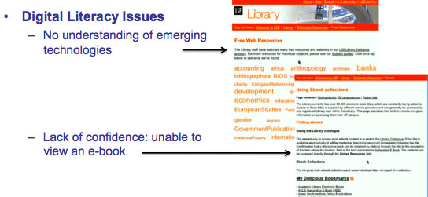
Confusion dealing with different systems: paradigm shift
Notes:
There are too many words. Normally I’d prefer a search box … not sure what to click on … business maybe (LP5)
‘I’m closing the E-book because I have no idea what to look at” – LP5
Participants seemed to find library resources too difficult and too complex – not user friendly;
they did not correct their spelling mistakes or suggest keywords or come up with auto-suggestions.
Time out was a problem as all searchers were lost
MP12 described them as ‘professional’ for ‘professionals’
Confusion and disorientation with the unfamiliar was common. What was Multisearch? What is Athens?
A user who saw the delicious bookmarks on the LSE website could not understand what to do – “there are too many words. . . what do I click on? Business, maybe?”
‘Users did not understand why Business Source Complete still came up with hits if none of the keywords they had input were correct – (this is a reference to the smart text search)
Usability issues:

Slide 13
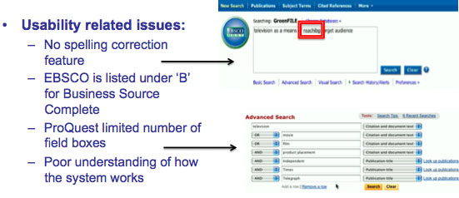
Confusion dealing with different systems: Usability
Notes:
The comments from one of the participants support this view:
CP4:’ I don’t know why you can’t … they might have change the functionality. You used to be able to just put in Times in ‘Publication Title’, which was really good because it would bring up the normal Times, The Financial Times and the Times on Sunday but now something seems to happen in ProQuest where … you can’t do that and so … which I don’t understand. Because now I have to pick each publication but this makes the amount of searching that I have to do more. Because now I have to do an increased amount of searches because I got to put The Daily Telegraph separately from the Sunday Telegraph where ordinarily I would just put Telegraph and it would bring up both for me. Because I haven’t got as many rows to add as I would like, because I normally do everything at once in one job … so I don’t know why it’s done that. But this is really irritating. I’m abandoning this because it’s too frustrating.’

Slide 14
Structure vs. Semantics
Database structures hinder finding information
Users need to learn the procedural knowledge for accessing and using the systems
“ The content in the academic databases isn’t organised very well … You need to have very advanced search skills to be able to get the best out of the internal resources …
Categorisation issues with library databases – if something is classified within a different discipline, you might not be able to access it.” (MP12, PhD student/researcher)
Notes:
Database structures hinder users finding information
Users have to learn the procedural knowledge for using a particular database, which obviously has limited transferability.
they need to have a basic idea of how the data table is organised, and to what subject matter does the built-in thesauri refer, how the terms have been indexed
For most users, their familiarity with search engines like Google, they have transferred their understanding of information search and retrieval to databases
users do not need to have an understanding of how the data is stored on the internet but when the internal resources are concerned >>

Slide 15
Need for storage and how it is used
Users need easy to use and re-access systems from where they were
Current systems lack common ways for users to keep track and organize their research
Storage features of systems under-utilized as they are all different
Web 2.0 storage not as pre-valent as thought
Low tech solutions: printing, bookmarks and tabs
“ I think the concept of saving to the desktop is getting more and more into the background … I tend to bookmark things more than save them because I’m assuming it will be there when I click the bookmark again.” (MP12, EX)
Notes:
The current systems lack good ways of storing and re-accessing documents allowing the users to create repositories of information that can be accessed easily and be transferable across different resources.
Storing relevant information allows users to keep track of material, organise their references, but importantly, also allows them to re-visit at anytime.
It was observed that users were un-aware of some of these features such as ‘alerting’ or ‘save searches’.
Participants often gathered information from various resources and put it together in an easily accessible place: a folder, a bookmark in a browser or a number of tabs.
The already existing storage spaces within various resource discovery systems were used very rarely and one can only assume that users were not aware of they existence, or not sure about what they offered.

Slide 16
Recommendations (subset)
Information and Digital Literacy
Better guides on availability of resources, access, search strategy
Embed information literacy at subject (module) level
Students are digitally literate – but ERDS should focus on better support of the resource discovery process and help students understand why a resource or database is useful
Address usability across the domain
Adoption of common techniques
Don’t present the “database” view
Address the time-out
Auto-spelling and auto-suggestion
Built in domain level ontologies
Avoid multiple sign-ins

Slide 17
The future is Invisique!

Slide 18
Acknowledgements
Participants form all three universities (Cranfield, LSE and Middlesex University) that took part in this study
Mary Betts-Gray - Business Information Specialist / Freedom of Information Officer from Cranfield School of Management, Cranfield University
Jean Sykes, Chief Librarian and Information Services Director, LSE
Francesca Ward, Circulation Team Leader, User Services Department Library, LSE

