Slide 1
Quality Management through Effective Knowledge Sharing
Elli Georgiadou
Middlesex University
School of Science and Technology

Slide 2
Outline
Quality Management: Planning, Assurance, Monitoring, Quality Improvement
Quality Management in HE
Dimensions of Quality in HE
Quality is in the eye of the stakeholders
Factors /forces demanding quality
Knowledge Creation in Organisations
Knowledge Sharing
Personal knowledge creation and benefits to organisation?
How to foster a Knowledge Sharing Culture?
Effective Knowledge Sharing

Slide 3
Quality management in HE
No consensus on how best to manage and measure quality within higher education institutions (HEIs).
A variety of approaches have been adopted mainly from the manufacturing, industrial and business sectors

Slide 4
Dimensions of Quality in HE
One of the most clearly defined sets of dimensions of quality for HE has been identified by Harvey and Knight (1996), who argue that quality can be broken down into five different but related dimensions:
• quality as exceptional (for example, high standards)
• quality as consistency (for example, zero defects)
• quality as fitness for purpose (fitting customer specifications)
• quality as value for money (as efficiency and effectiveness)
• quality as transformative (an ongoing process that includes empowerment to take action and enhancement of customer satisfaction).

Slide 5
Quality is in the eye of the stakeholders
Different stakeholders are likely to value the importance of these different dimensions of quality according to their particular motivations and interest and interpret them differently.
For example, quality as value for money is likely to be judged differently even by various internal stakeholders. Students may judge value for money according to tuition fees paid versus contact time supplied, whereas a department manager is likely to be more concerned with the effective use of resources in relation to student numbers.

Slide 6
Factors /forces demanding quality
HE stimulates economic growth
HE for the ‘ masses’
Increased accountability
Greater expectations and diversity of students as consumers
Need for flexibility in provision
Increased competition (national/international)
These forces demand that quality assurance processes are both rigorous and transparent, and that quality enhancement initiatives are firmly embedded in any quality management programme.

Slide 7
Knowledge Creation in Organisations
Continuous knowledge creation requires voluntary actions requiring openness, scrutiny, trust and tolerance towards different views and interpretations
The constructive learning process in the work-place is revealed through bottom-up knowledge creation spread from individual to individual in the socialization process
The organisation’s responsibility is to align organisational learning investment with organisational value outcome taking into account both current and future organisational tasks

Slide 8
Knowledge Sharing
Knowledge sharing is aided, hindered, moulded by
individual, organisational and national culture
attitudes
slogans
symbols
heroes and rituals

Slide 9
Knowledge Creation in Organisations
Continuous knowledge creation requires voluntary actions requiring openness, scrutiny, trust and tolerance towards different views and interpretations
The constructive learning process in the work-place is revealed through bottom-up knowledge creation spread from individual to individual in the socialization process
The organisation’s responsibility is to align organisational learning investment with organisational value outcome taking into account both current and future organisational tasks

Slide 10
Why is the creation and application of new knowledge essential to the survival of organisations?
Increasing staff turn over
Intangible products
Continuous innovation
Lack of awareness of existing knowledge
Accelerating change in technology generates difficulties in catching up

Slide 11
Relevant Research by
Hofstede
Trompenaars
Schein
Triandis
Biro
Balstrup
Siakas
Georgiadou

Slide 12
Expected Outcomes from effective Knowledge Sharing
Improved organisational learning
New knowledge creation and innovation
Knowledge re-use
Since knowledge is primarily created by individuals a company-wide cultural change, including effective collaboration and communication, is needed for embracing knowledge sharing initiatives

Slide 13
How to foster a Knowledge Sharing Culture?
By promoting and rewarding
Creativity
Inventiveness
Active exchange of ideas
Change

Slide 14
Cultural Diversity: an opportunity or a hindrance
Since all individuals carry with them the mental cultural programming since childhood an organisational change may conflict with their basic national values
Organisations operate on a global scale
Culturally diverse workforce
Organisations which recognise and cater for diversity have a competitive advantage

Slide 15
Effective Knowledge Sharing
Effective Knowledge Sharing is a critical organisational factor
National and the organisational culture are decisive for moulding, hindering or aiding attitudes regarding knowledge sharing and organisational knowledge
Willingness to share knowledge is influenced by cultural dynamics from the external environment (national culture) and from the internal environment (organisational and individual culture)

Slide 16
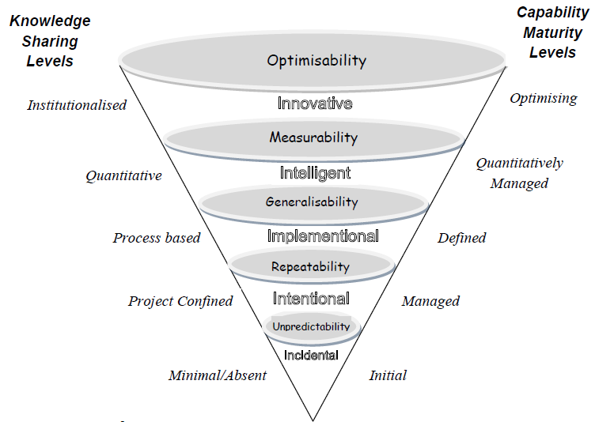
The I5P Visualisation Framework for Performance Estimation through the Alignment of Process Maturity and Knowledge Sharing [Georgiadou et al]

Slide 17
I(1) - Incidental
This is the level where the processes are simply performed in an ad-hoc manner and are characterised by unpredictability. Knowledge resides with individuals and knowledge sharing is absent or minimal.

Slide 18
I(2) - Intentional
At this level the project management is characterised by repeatability. Best practice has been identified and documented, so that knowledge about successful practices can be shared amongst the project team. Subsequent projects undertaken by the team benefit as the characteristic of repeatability.

Slide 19
I(3) - Implementational
At this level processes are defined and generalisable.
Knowledge is shared between projects.

Slide 20
(4) - Intelligent
At this level processes are performed, repeatable, defined and managed. Measurability is the main characteristic of the processes which in turn provides useful intelligence thereby enhancing performance at an institutional level. Knowledge sharing is institutionalised.

Slide 21
I(5) – Innovative / Improving
This level is characterised by optimisability and continuous improvement. Knowledge sharing is institutionalised and quantitative. Improvements are achieved from continuous feedback, across teams, within and across projects and across the whole organisation. All employees understand, embraced and practice the philosophy of knowledge sharing. Processes are continuously improving and innovative ideas of all employees find fertile ground.

Slide 22
Knowledge Sharing Strategies
Show benefits – 1 2 - Build trust
Support by Technology - 8 3 - Reward desired behaviour
Learn from mistakes - 7 4 Create Role Models
Train stakeholders - 6 5 - Include in job
descriptions

Slide 23
Advantage through Knowledge Sharing and Collaboration

Slide 24
Thank you
Elli Georgiadou
e.georgiadou@mdx.ac.uk

